Slide 1
Mini Project #2
File created on: 6/23/2025 11:32:13 AM

Slide 2


Slide 3
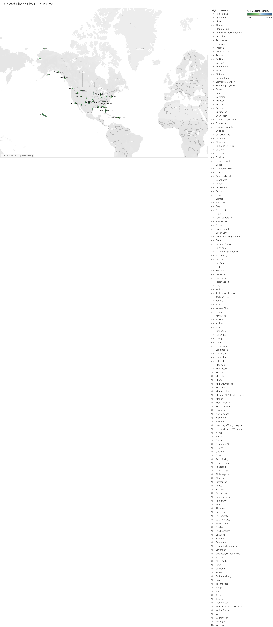

Slide 4
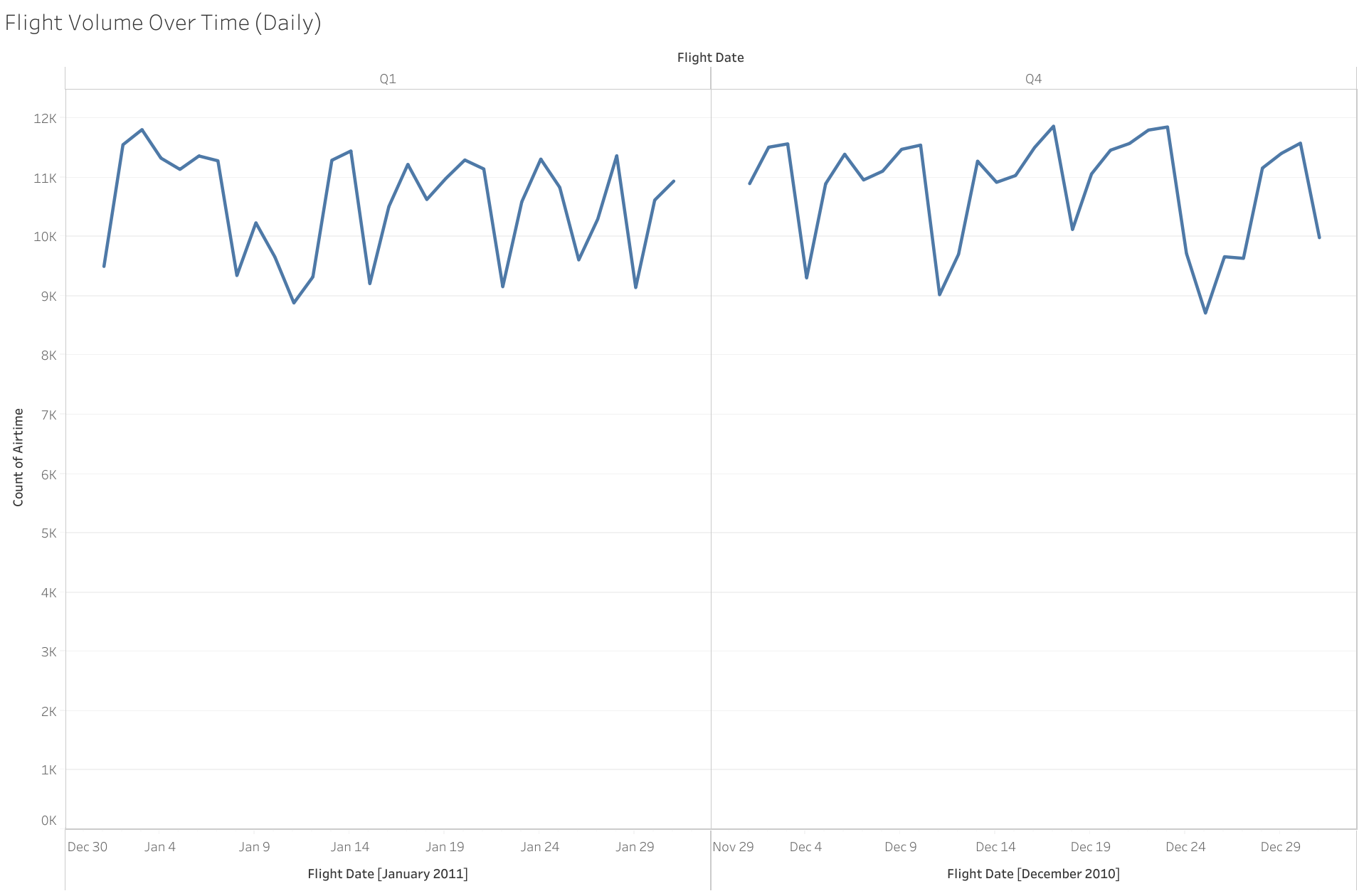

Slide 5
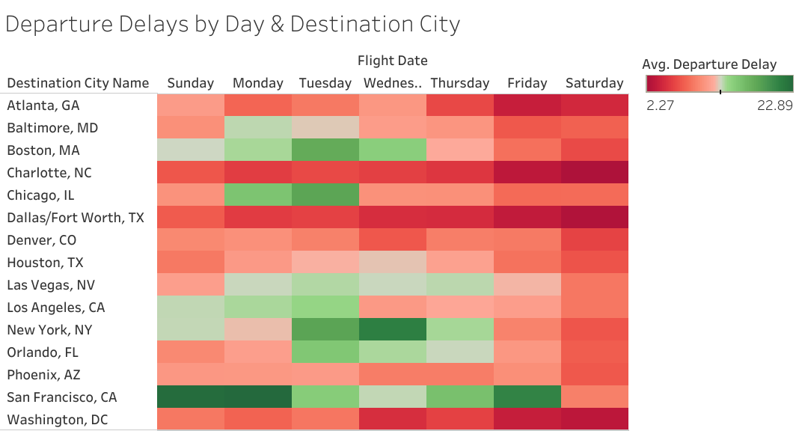

Slide 6
